Slide 1

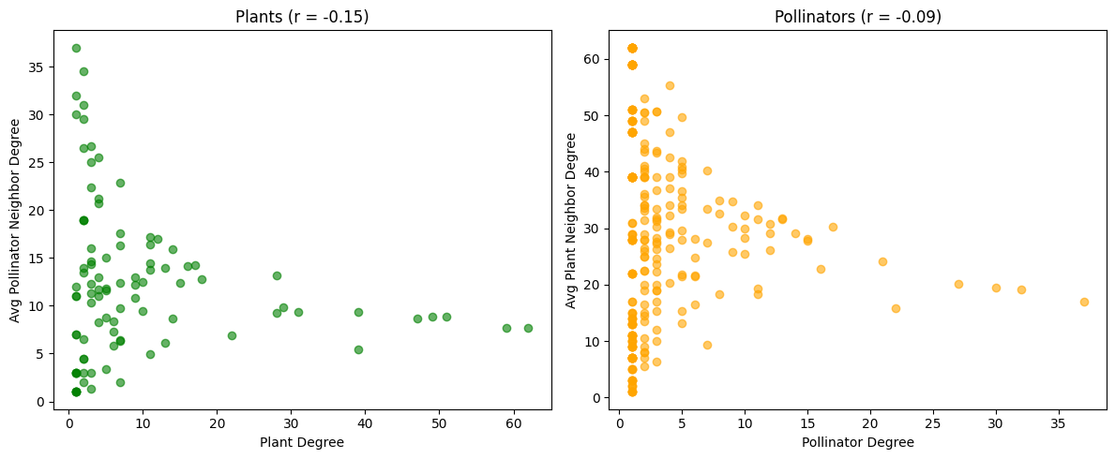

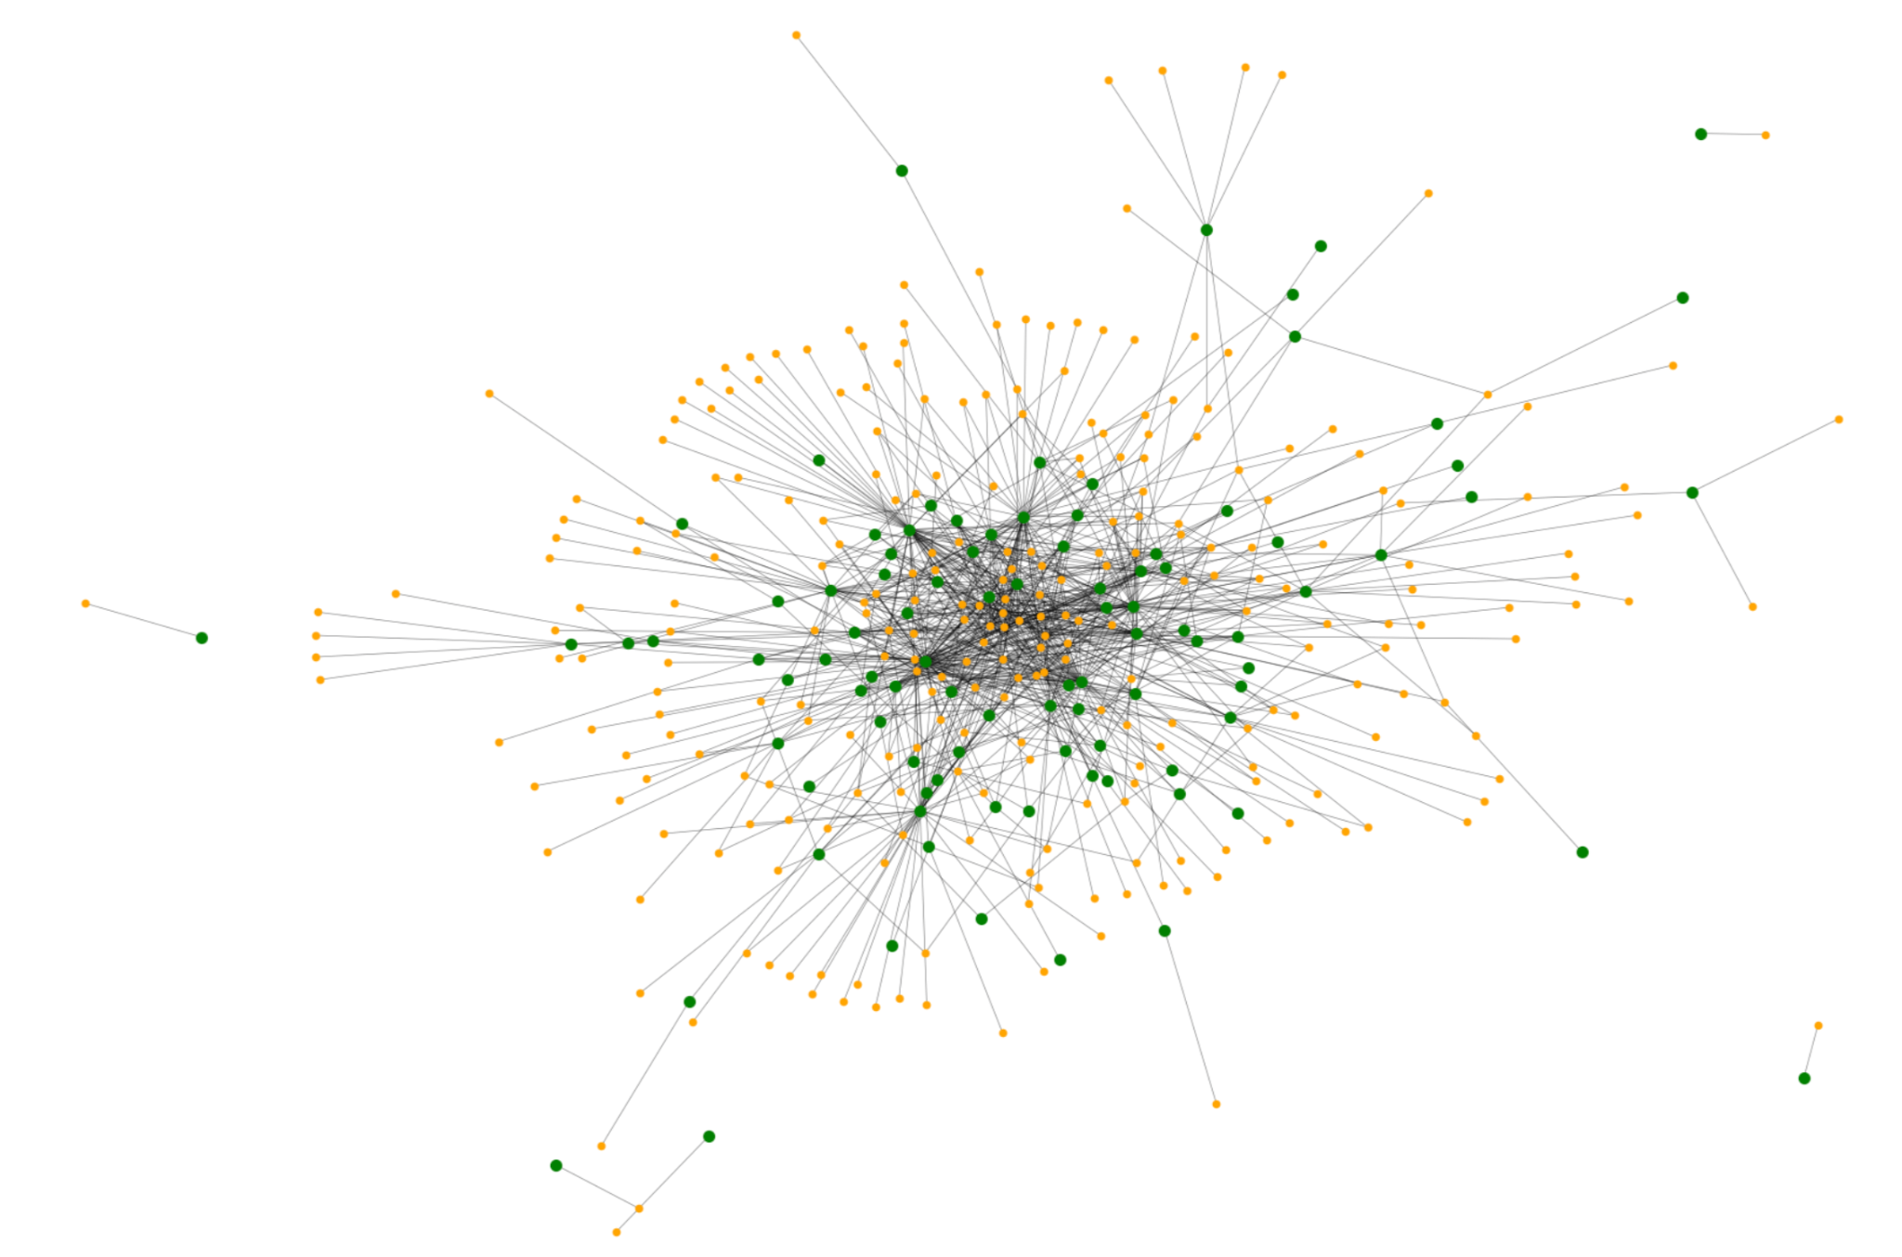
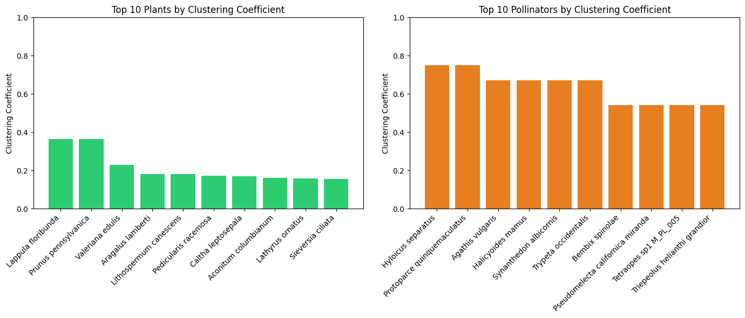
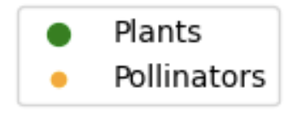
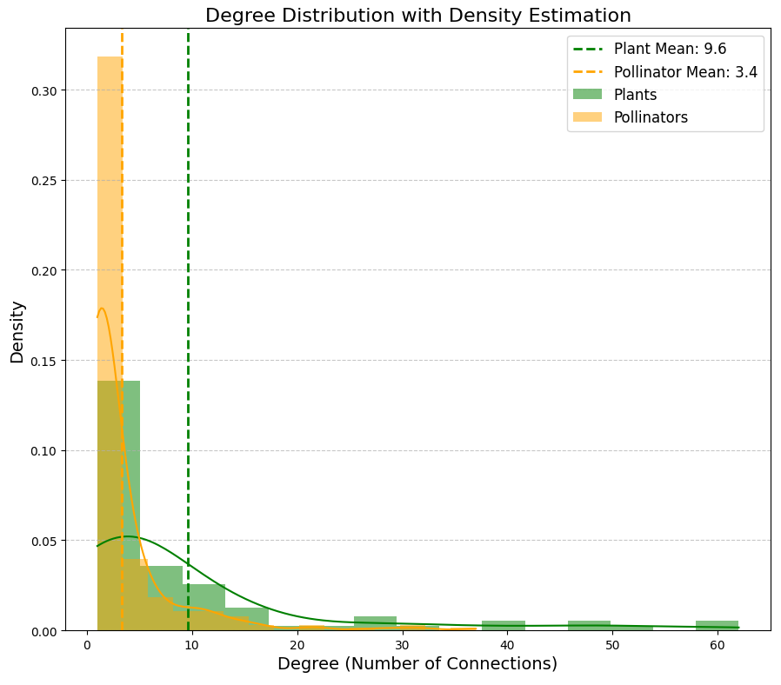
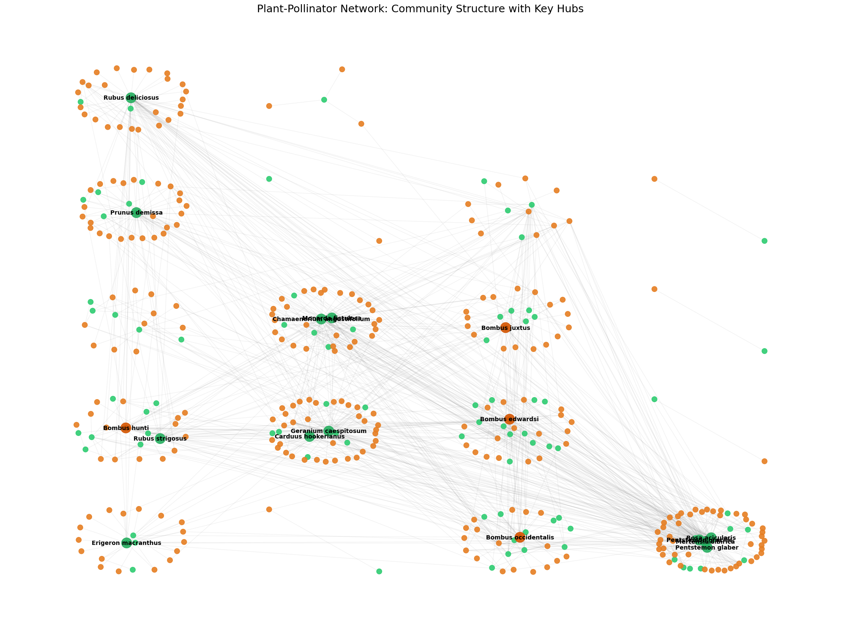
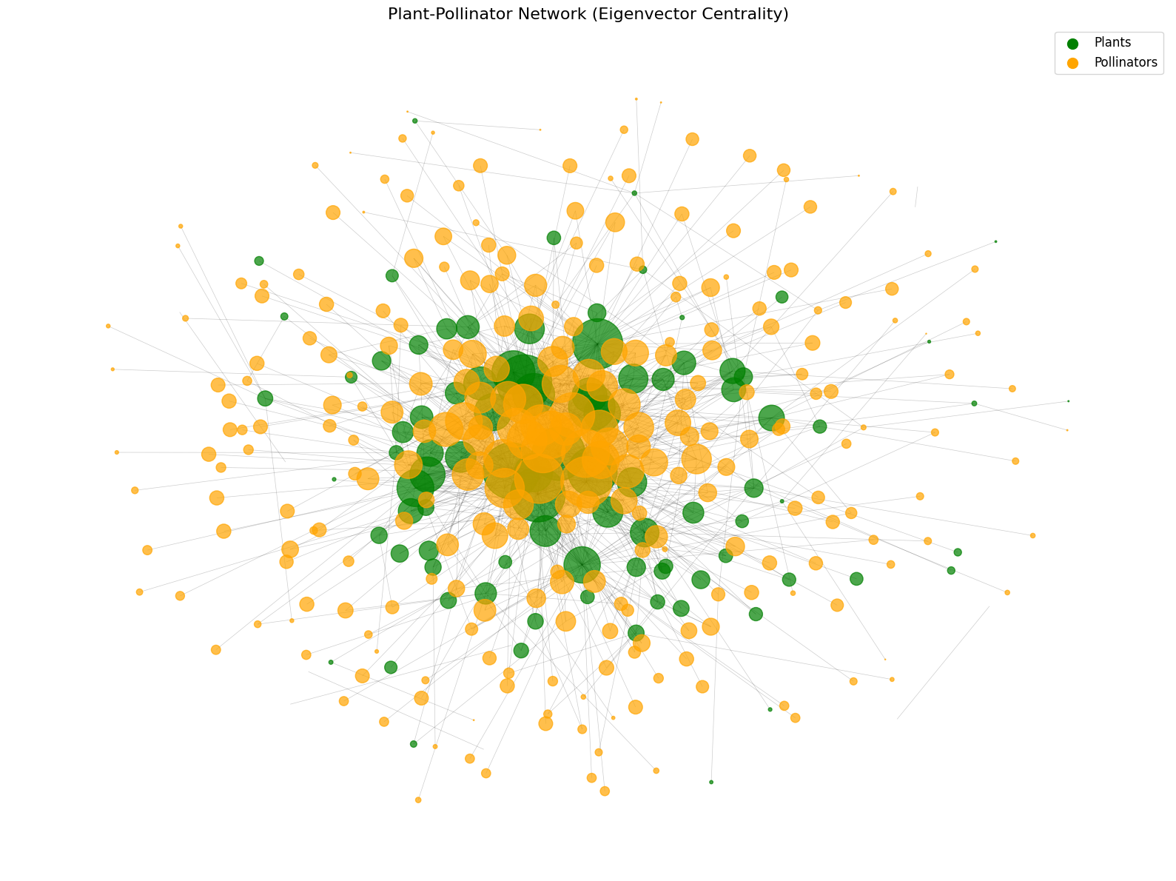

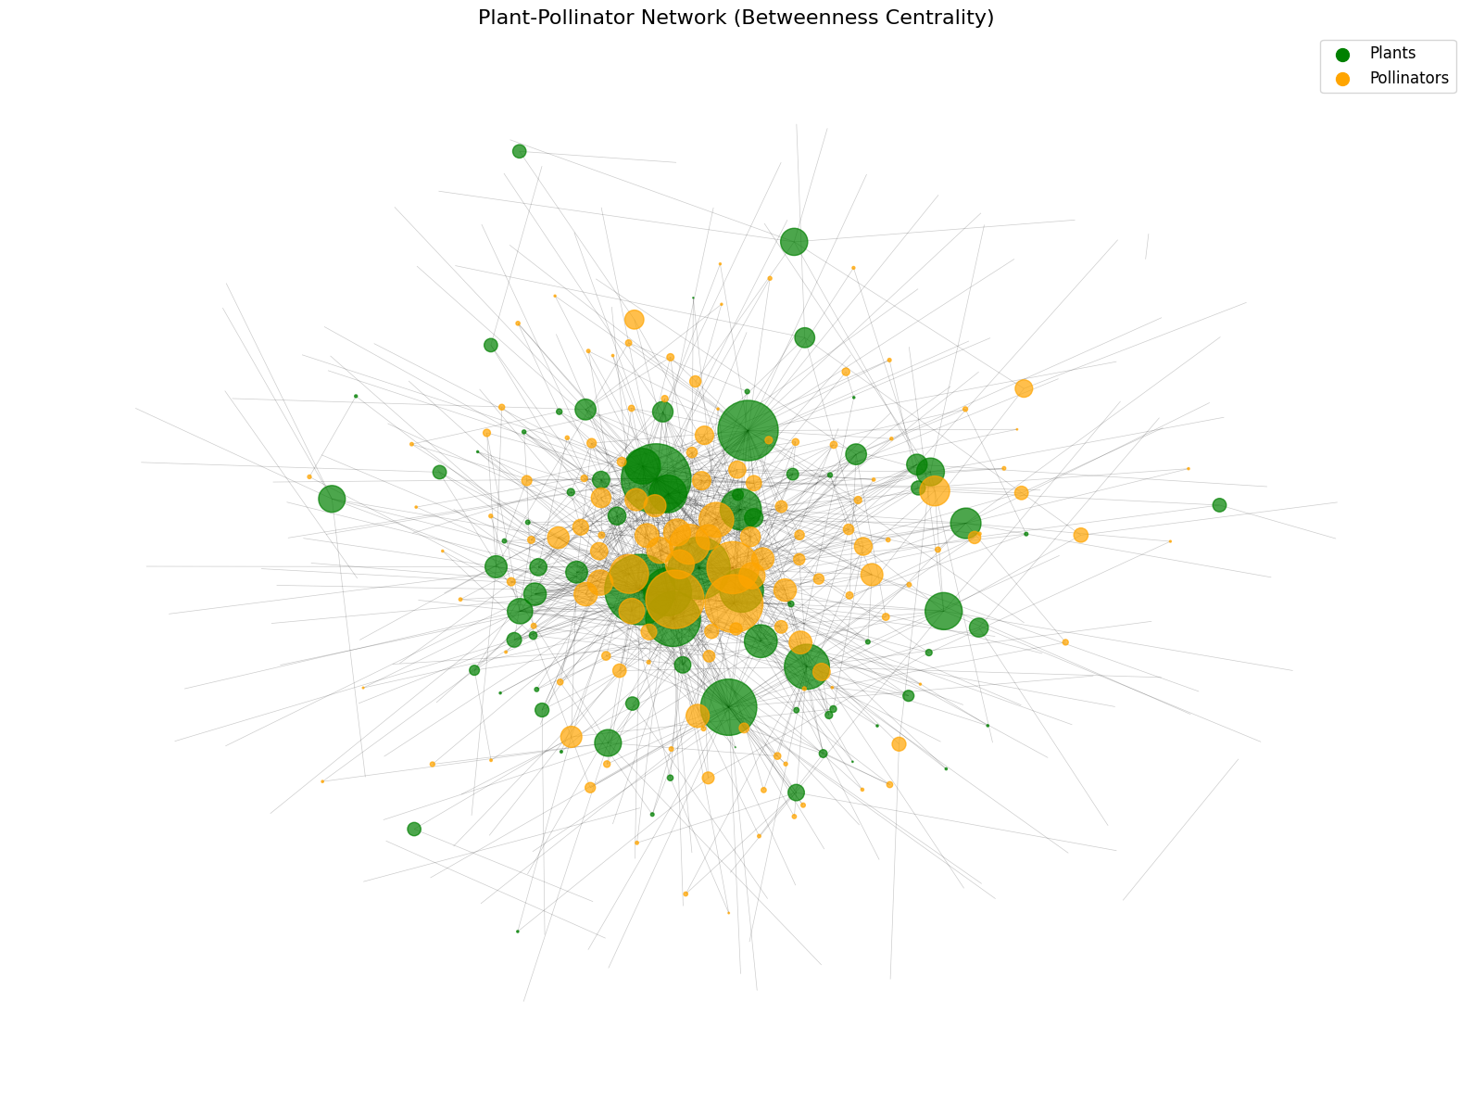
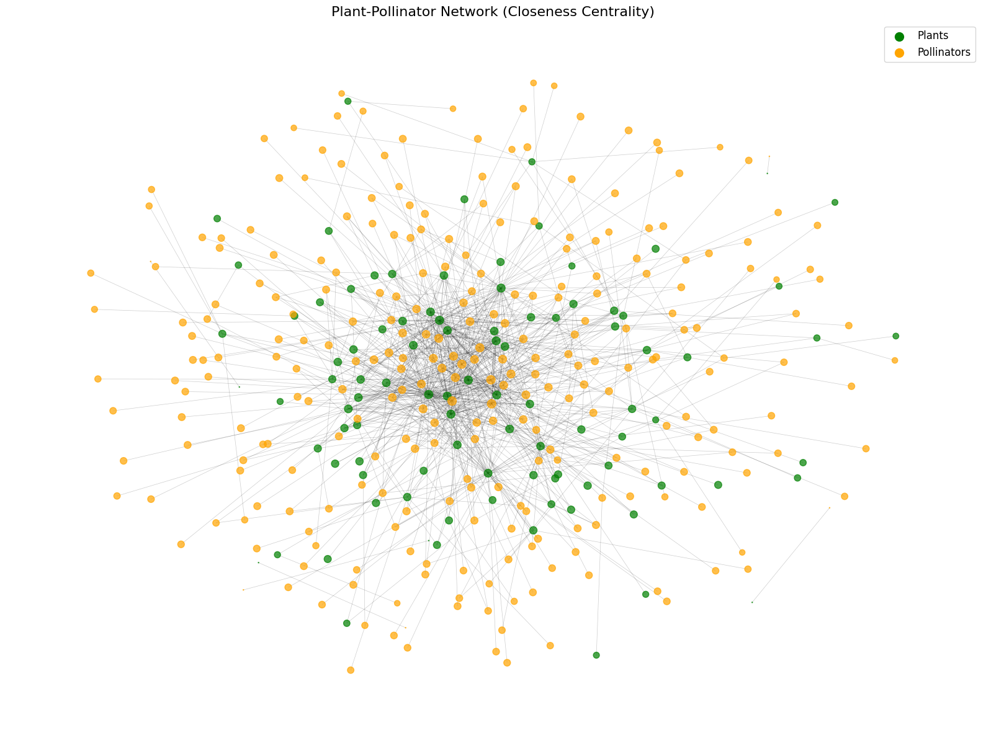
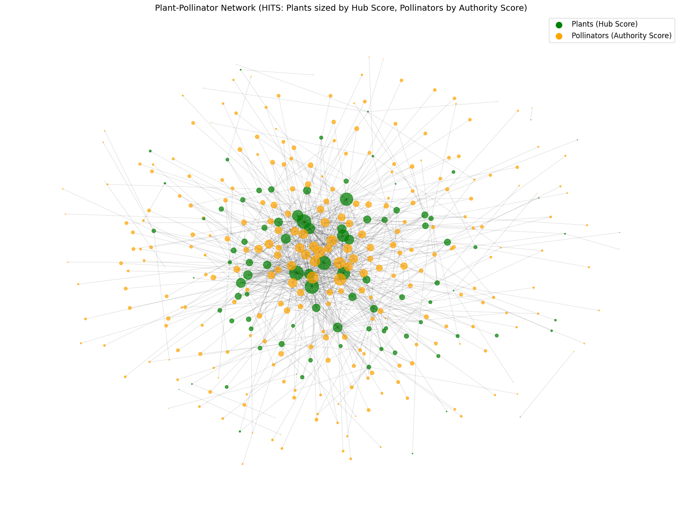
Analysis of Plant-Pollinator Network
SANKALP RAMPURIYA, VEDANT NUWAL
Department of Civil Engineering, Department of Civil Engineering
ES 404
1. Introduction
4. Methodology
This study analyzes a real-world plant-pollinator bipartite network where nodes are plant and pollinator species (96 & 275 respectively); edges are pollination interactions(923).
The aim is to identify generalist and specialist species, communities, and interaction patterns for ecosystem stability.
Centrality Analysis: Calculated Eigenvector, Katz, Betweenness, Closeness, and HITS centralities for all nodes.
Community Detection: Louvain algorithm used to identify modules and compute modularity.
Assortativity: Pearson degree correlation measured separately for plants and pollinators.
Clustering Coefficient: Computed global and local clustering coefficients for both node types.
Visualization: All plots generated in Python/Jupyter.
Fig 8.Average neighbor degree vs. node degree
5. Results
Fig 9. Local Clustering Coefficients
6. Conclusion
Key Generalist Species: Generalist species like Rubus deliciosus (plant) and Bombus edwardsi (pollinator) function as crucial hubs and bridges in the network; their removal fragments the network, isolates specialists, and can trigger cascading co-extinctions.
Most Vulnerable Species: The most vulnerable pollinators (Anthomyia sp1, Archytas sp1, and Exoprosopa volucris) have the lowest centrality and depend on specific plants, making them especially prone to extinction.
Restoration Priorities: Restoration efforts should prioritize highly central plants such as Rubus deliciosus, Geranium caespitosum, and Rosa acicularis to maintain pollinator diversity and network connectivity.
Functional Redundancy: Key plants like Rubus deliciosus have backup pollinators, including Bombus edwardsi and Bombus occidentalis, which provide functional redundancy and help buffer against pollinator loss.
Network Properties: The network’s disassortative mixing (r = –0.15 for plants) means generalists connect to many specialists, making the system robust to random specialist loss but fragile if hubs are lost.
Community and Co-Decline: Species within the same community module are likely to co-decline under environmental stress, and targeted removal of bridge species like Rubus deliciosus or Bombus occidentalis rapidly fragments the network. (Modularity = 0.395)
Fig 1. Plant-Pollinator Network
2. Research Questions
Fig 2. Degree Distribution
Fig 3. Plant-Pollinator Network Community structure with Key hubs (Modularity = 0.395)
How removing generalist species affect network stability?
Which specialist pollinators are vulnerable to extinction?
Which plants would be most effective in restoration?
What are backup pollinators for key plant species?
How does the disassortative mixing pattern for plants influence resilience to species extinction?
Which species might co-decline under environmental stressors?
What are the ecological implications of pollinators showing a significantly higher global clustering coefficient than plants?
Fig 4. Eigen Centrality
Fig 5. Betweenness Centrality
Node size represent centrality values
3. Datasets
The dataset comes from the Web of Life ecological networks database (M_PL_005.csv) and represents a plant-pollinator network from the Colorado region of the United States. This bipartite network captures the ecological interactions between plants and their insect pollinators in this ecosystem.
7. References
Web of life: Ecological networks database. Web of Life: ecological networks database. https://www.web-of-life.es/
Bhatia, U., Dubey, S., Gouhier, T.C. et al. Network-based restoration strategies maximize ecosystem recovery. Commun Biol 6, 1256 (2023). https://doi.org/10.1038/s42003-023-05622-3
Fig 6. Closeness Centrality
Fig 7. Plants sized by Hub score and Pollinators by Authority score.
sankalp.rampuriya@iitgn.ac.in, vedant.nuwal@iitgn.ac.in

